Slide 1
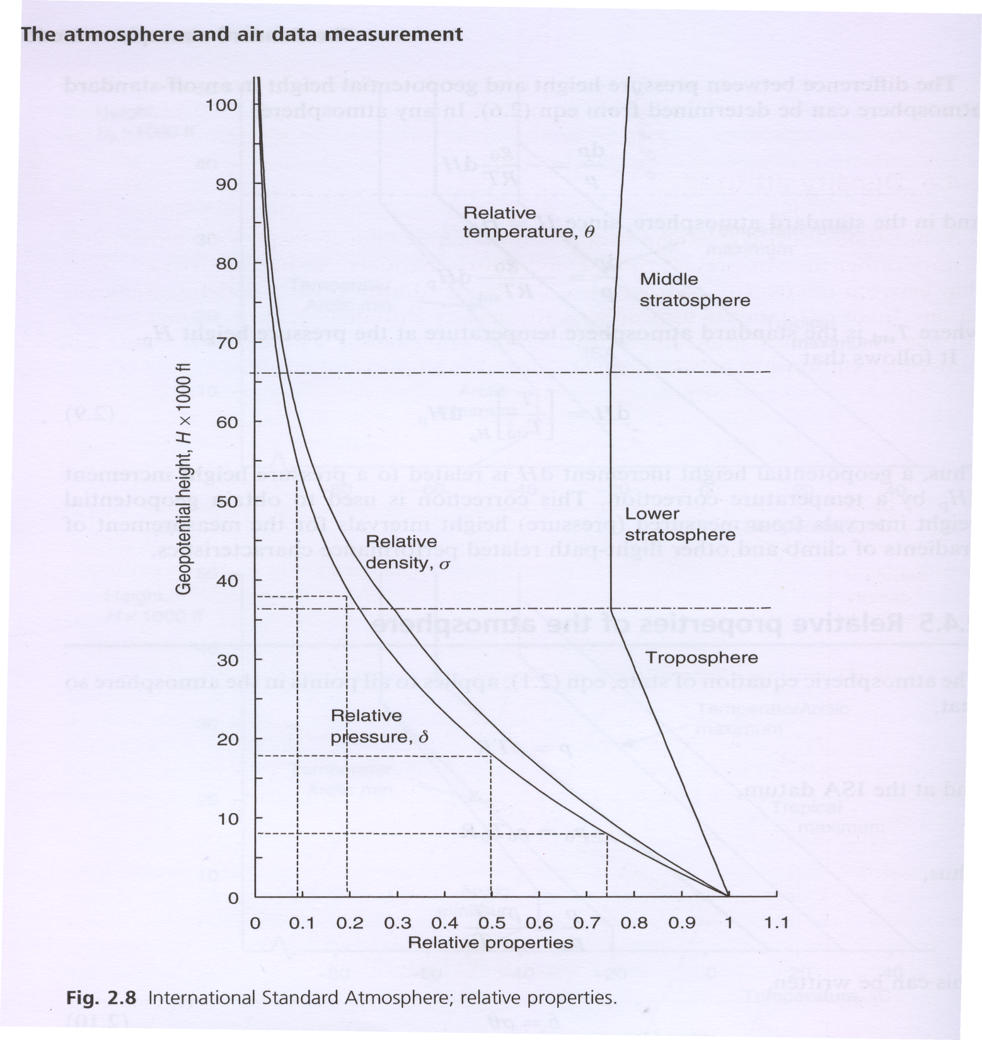

Slide 2
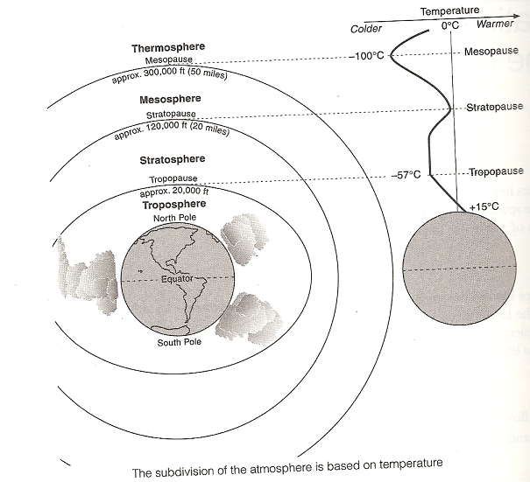
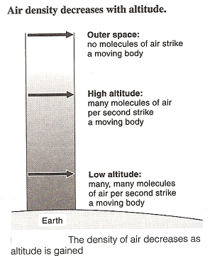

Slide 3
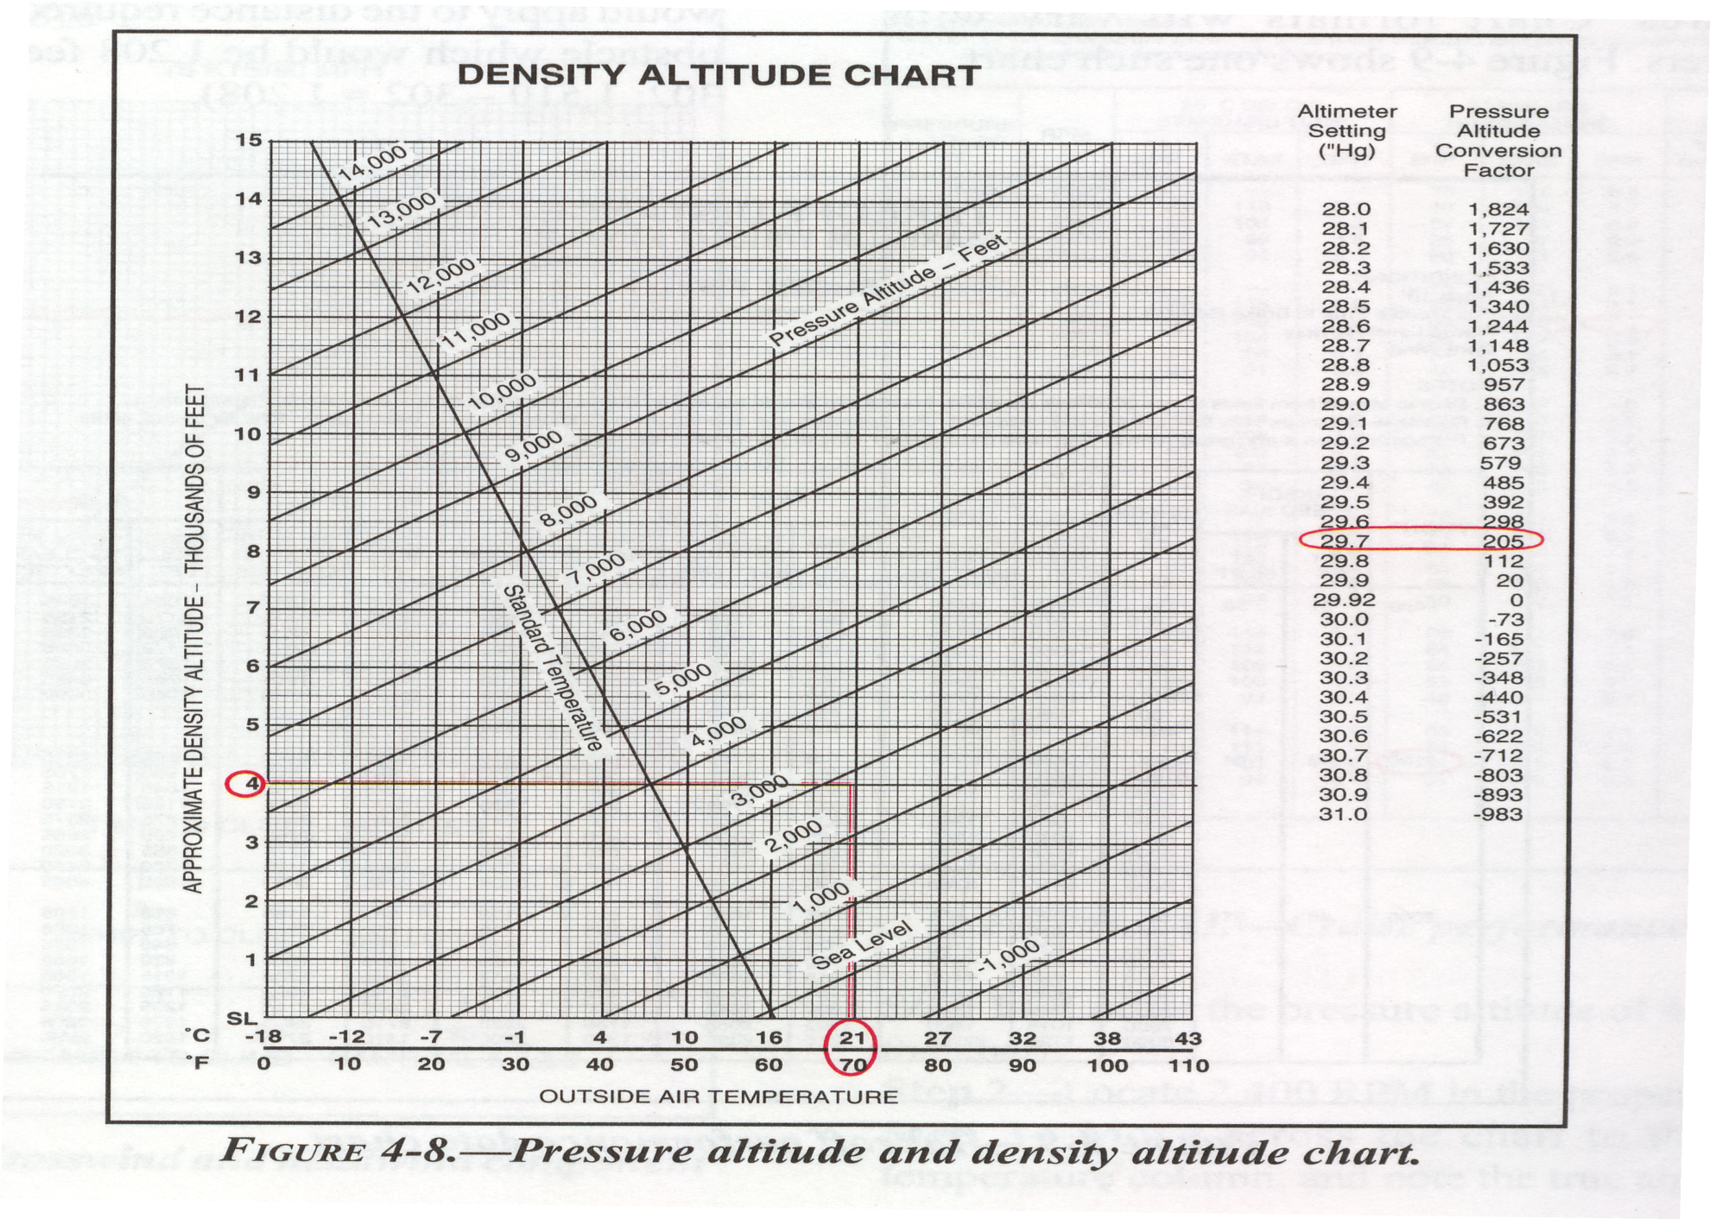
In Class Quiz.
Using the density altitude chart, what is the density altitude if the altimeter reads 5000ft with 28.30 in.Hg in the
Pressure window and the true outside air temperature is 90 F?

